Slide 1
BEST LOCATION FOR OPENING RESTAURANT IN MUMBAI
BY - DIVYA S
DATE - APRIL 9, 2021

Slide 2
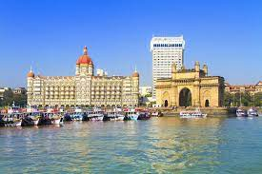
INTRODUCTION
Mumbai is known to be the capital of finance and economy of India .
It is one of the major hubs of the world and is extremely diverse with people from various ethnicities residing here.
Thus, the aim of this project is to study the neighborhoods in Mumbai to determine possible locations for opening a restaurant.
This project can be useful for business owners and entrepreneurs who are looking to invest in a restaurant in Mumbai. The main objective of this project is to carefully analyze appropriate data and find recommendations for the stakeholders.

Slide 3
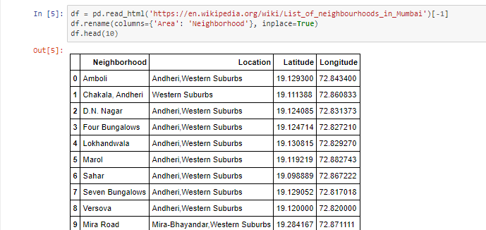
DATA COLLECTION
The data of the neighborhoods in Chennai was scraped from https://en.wikipedia.org/wiki/List_of_neighbourhoods_in_Mumbai. The data is read into a pandas data frame using the read_html() method. The main reason for doing so is that the Wikipedia page provides a comprehensive and detailed table of the data which can easily be scraped using the read_html() method of pandas.

Slide 4
GEOGRAPHICAL COORDINATES
The geographical coordinates for Mumbai data has been obtained from the GeoPy library in python. This data is relevant for plotting the map of Mumbai using the Folium library in python. The geocoder library in python has been used to obtain latitude and longitude data for various neighborhoods in Mumbai. The coordinates of all neighborhoods in Mumbai are used to check the accuracy of coordinates given on Wikipedia and replace them in our data frame if the absolute difference is more than 0.001. These coordinates are then further used for plotting using the Folium library in python.

Slide 5
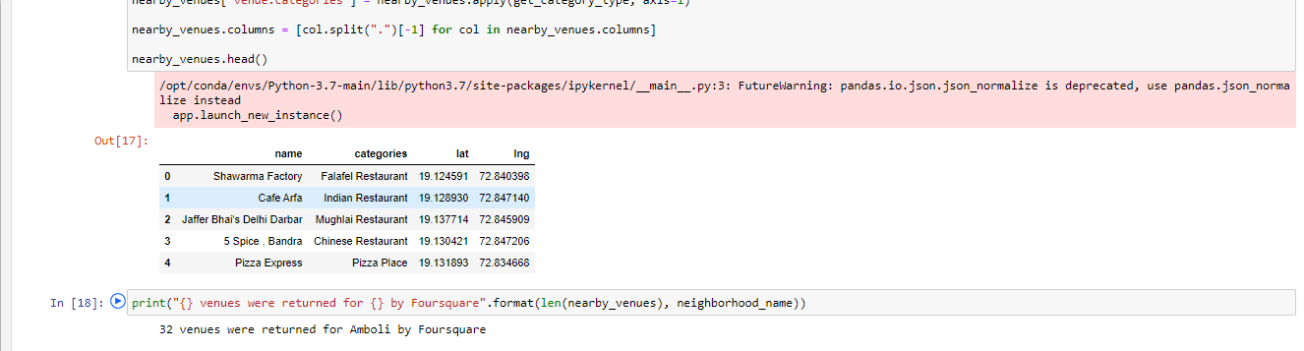
VENUE DATA
The venue data has been extracted using the Foursquare API. This data contains venue recommendations for all neighborhoods in Mumbai and is used to study the popular venues of different neighborhoods.

Slide 6
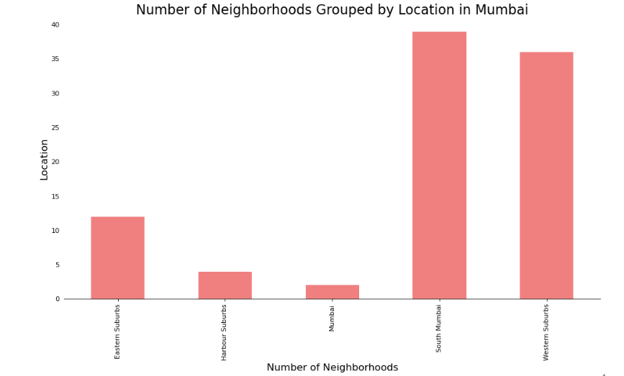
DATA VISUALIZATION

Slide 7
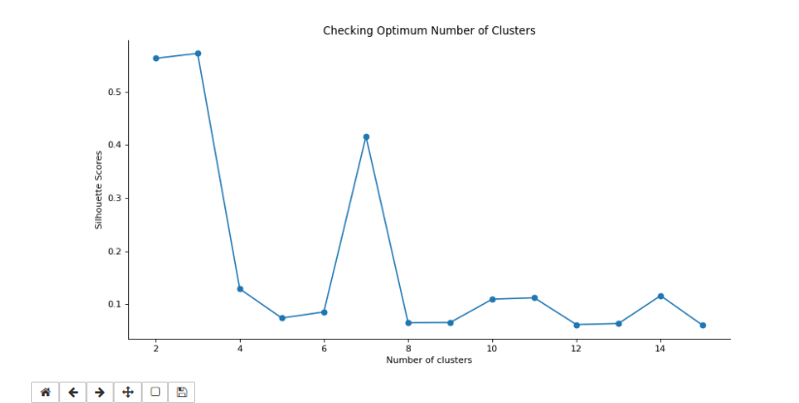
DATA VISUALIZATION CONTINUED
UNSUPERVISED LEARNING-

Slide 8
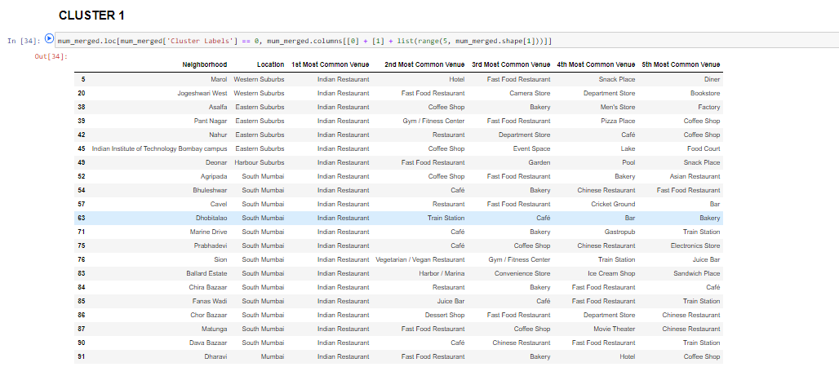
CLUSTER 1
ANALYZING DIFFERENT CLUSTERS

Slide 9
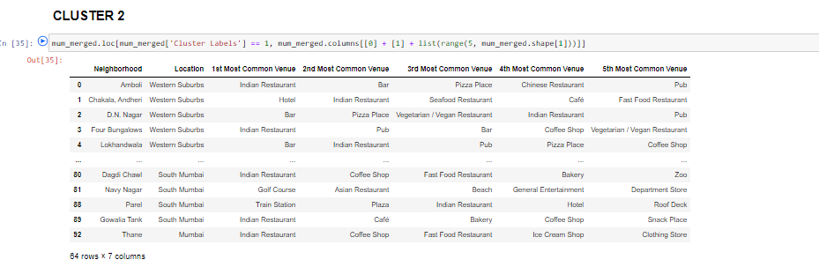
CLUSTER 2

Slide 10
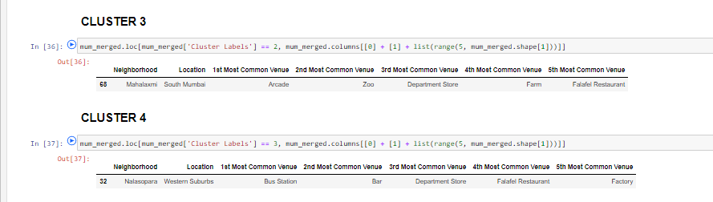
CLUSTER 3 & 4

Slide 11
RESULT AND DISCUSSION
By analyzing the five clusters obtained we can see that some of the clusters are more suited for restaurants and hotels, whereas, other clusters are less suited. Neighborhoods in clusters 3, 4 contain a small percentage of restaurants, hotels, cafe and pubs in their top 10 common venues. These clusters contain a higher degree of other venues like train station, bus station, fish market, gym, performing arts venue and smoke shop, to name a few. Thus, they are not well suited for opening a new restaurant. On the other hand, neighborhoods in clusters 1 and 2 contain a much higher degree of restaurants, hotels, multiplex, cafes, bars and other food joints. Thus, the neighborhoods in these clusters would be well suited for opening a new restaurant.
Comparing clusters 1 and 2, neighborhoods in cluster 1 seem to be more suited for starting a restaurant since they contains a larger percentage of food joints in the top 10 most common venues than cluster 2. The neighborhoods in cluster 1 contain a variety of food joints like restaurants, tea rooms, bakery, cafe, steakhouse and pubs and also contain very diverse cuisines like Japanese, Indian, Chinese, Italian and seafood restaurants. Most neighborhoods in cluster 2 seem to have Indian Restaurant as their top most common venue; however, on careful analysis we can see that neighborhoods in cluster 2 also contain other venues like soccer field, flea market, smoke shop, gym, train station, dance studio, music store, cosmetics shop and so on. Thus, it is recommended that the new restaurant can be opened in the neighborhoods belonging to cluster 1.

Slide 12
CONCLUSION
We have successfully analyzed the neighborhoods in Mumbai, India for determining which would be the best neighborhoods for opening a new restaurant. Based on our analysis, neighborhoods in cluster 1 are recommended as locations for the new restaurant. This has also been plotted in the map above. The stakeholders and investors can further tune this by considering various other factors like transport, legal requirements, and costs associated. These were out of the scope for this project and thus were not considered.

